Slide 1
Credit: Rachel P Blake
Fashion & Fairytale

Slide 2
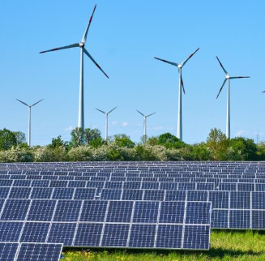
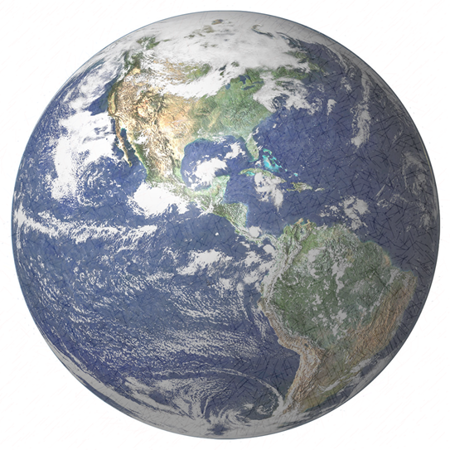
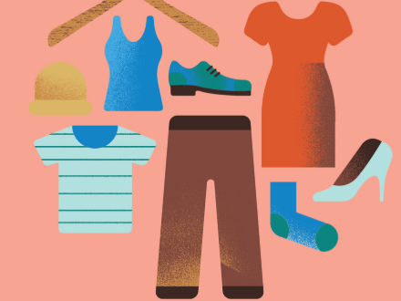
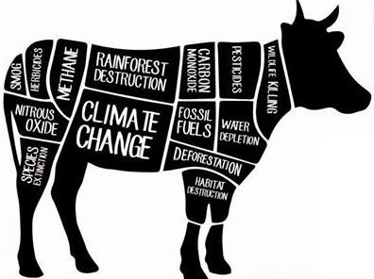
Credit: Rachel P Blake
What can we
do about climate change?

Slide 3
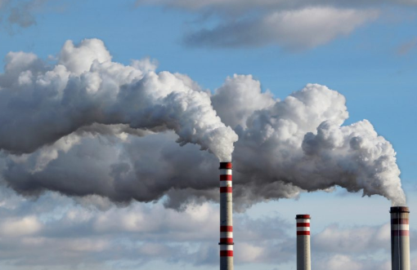
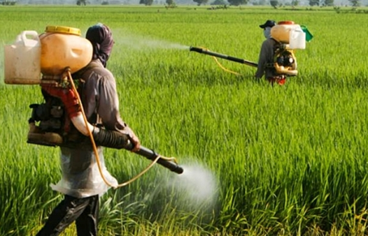
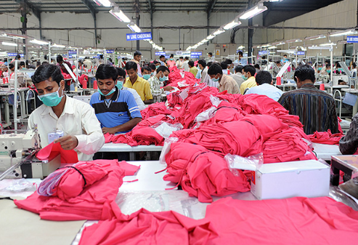
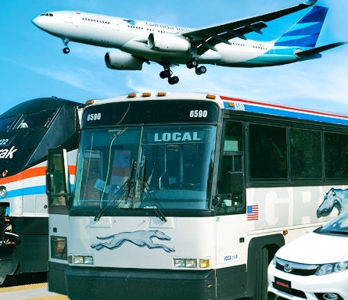
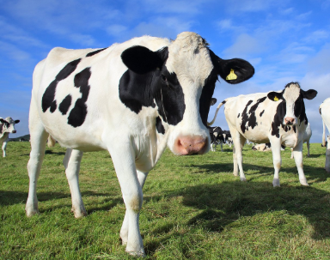
Credit: Rachel P Blake
The planet’s biggest polluters
Fossil fuels
Farming & agriculture
Textile production
Meat & dairy
Transport

Slide 5
Credit: Rachel P Blake
What is fast fashion?

Slide 6
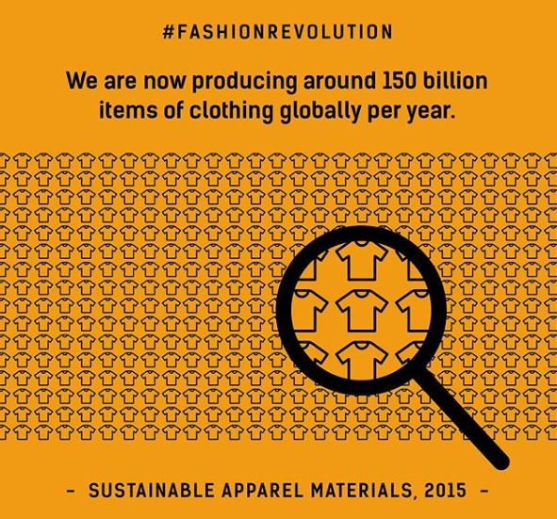

Slide 7
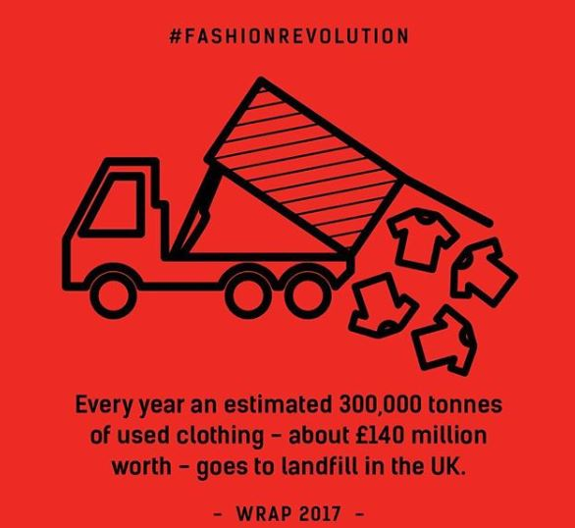

Slide 8
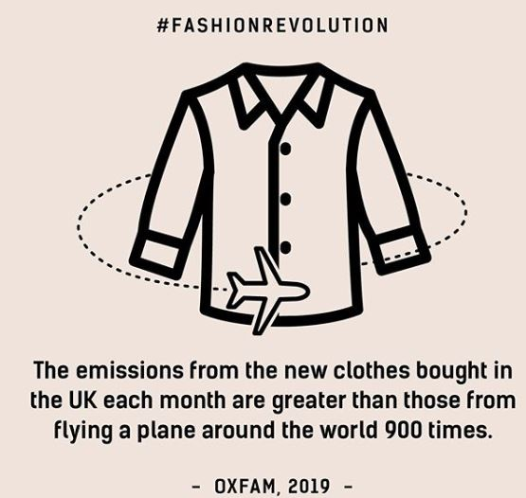

Slide 9
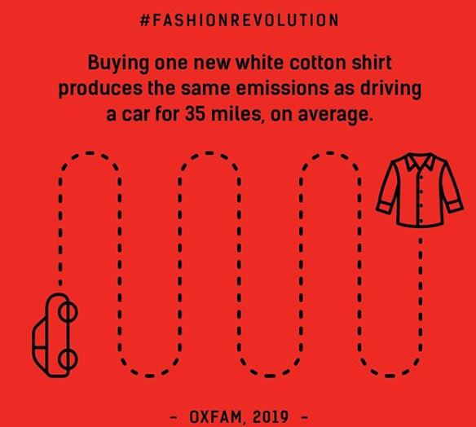

Slide 10
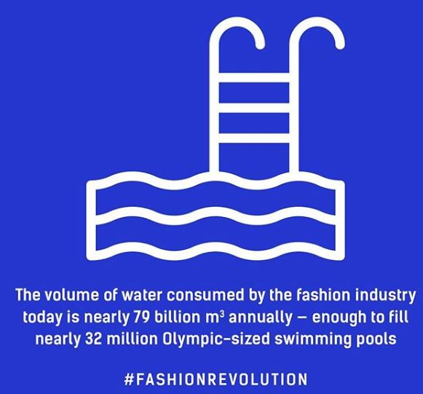

Slide 11
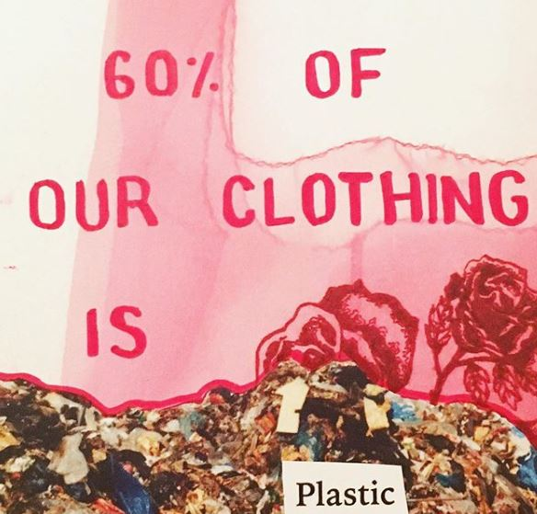

Slide 12
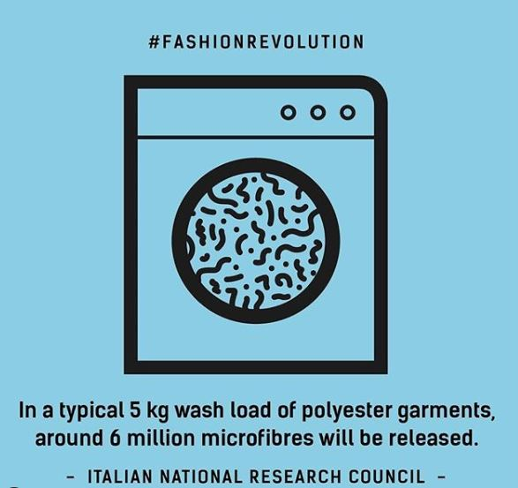

Slide 13
Credit: Rachel P Blake
Buy second hand instead of new
Choose better quality items which are made to last
Wear what we already have
What can we do to be more environmentally friendly?
Borrow and swap clothes with friends
Upcycle clothing and create something new from old
Learn about who makes the clothes and whether they are treated fairly
Choose items made from sustainable fabrics
Buy from local makers

Slide 14
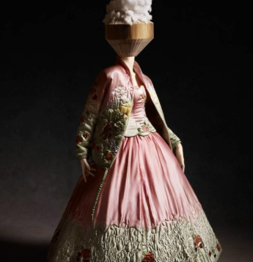
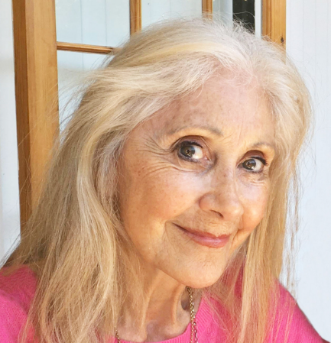
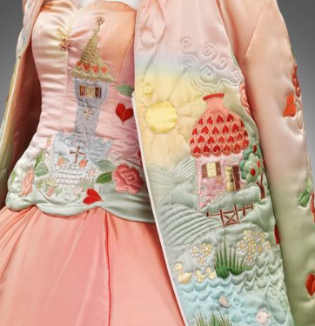
Cindy Beadman

Slide 15
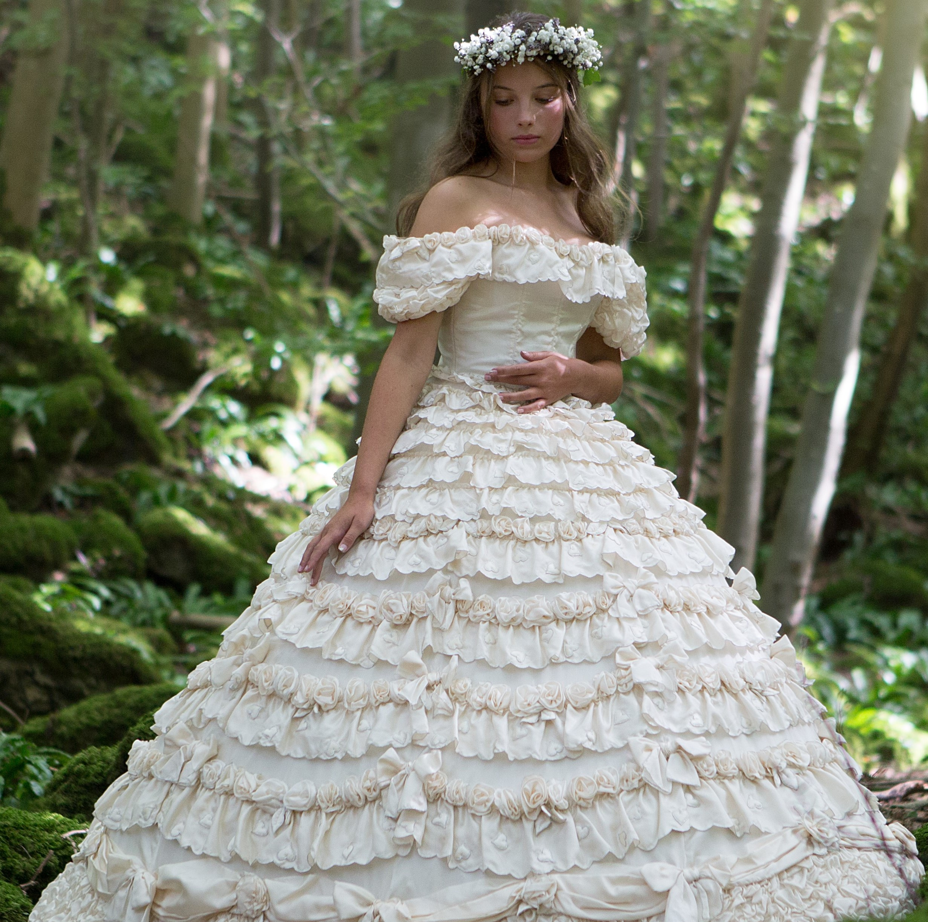
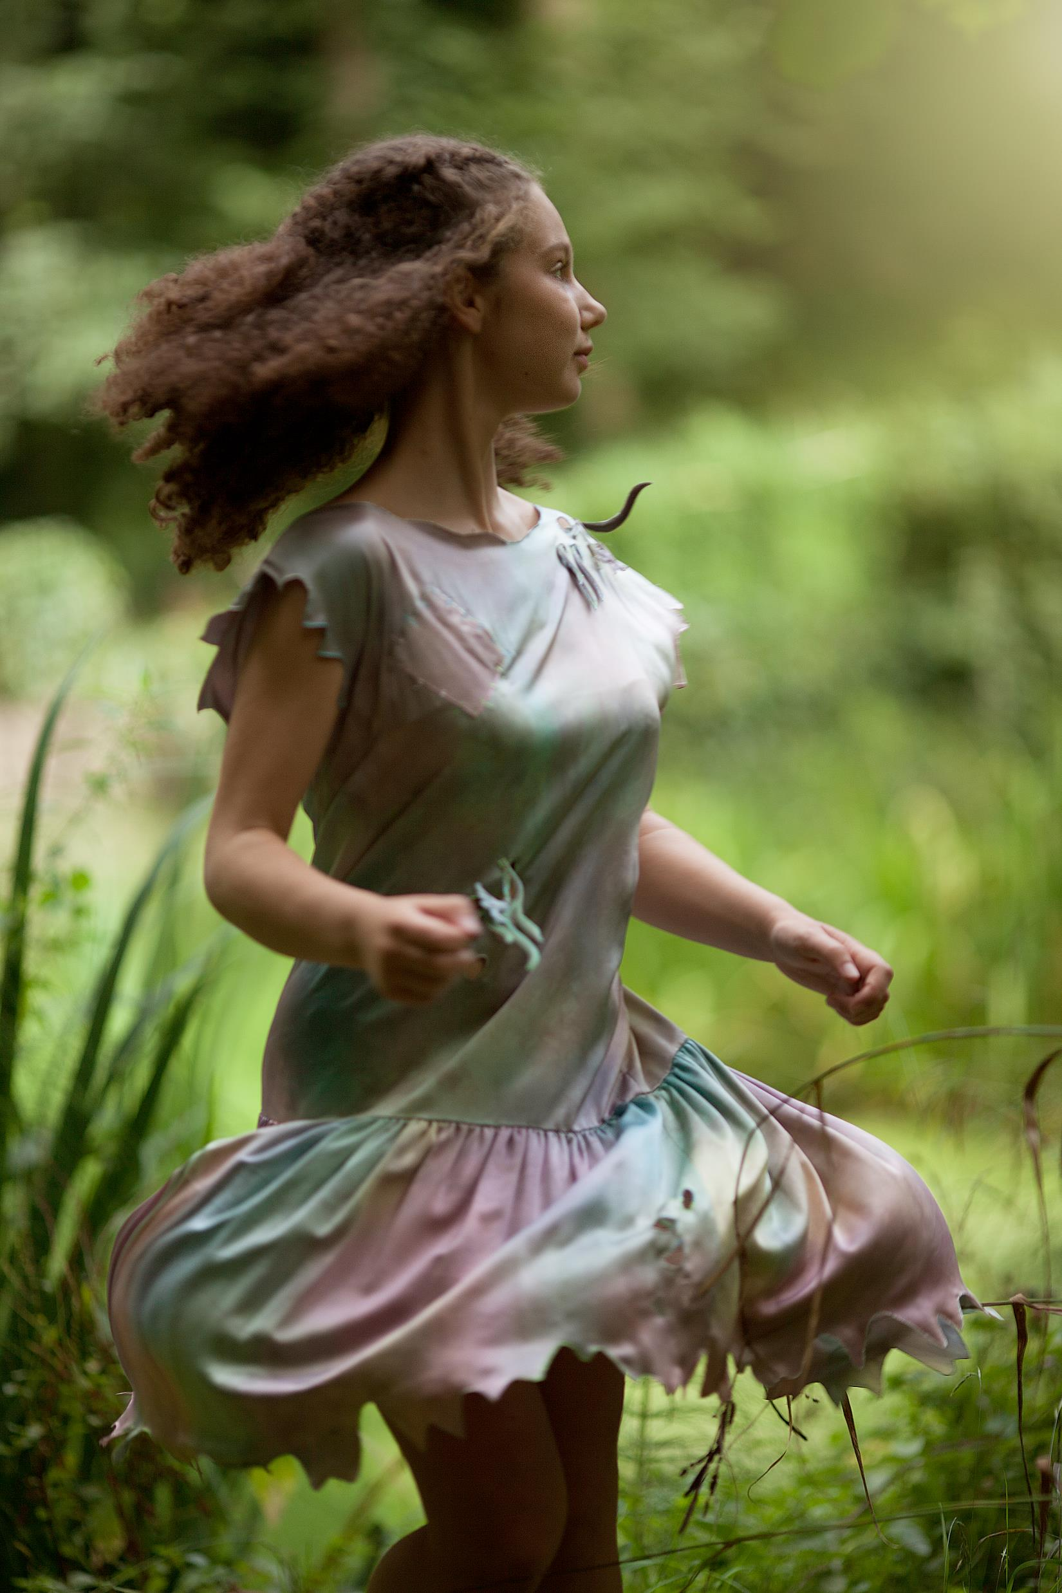

Slide 16
Fashion and fairytale: HALF TERM TRAIL & Sustainable Fashion design competition
Love fashion but hate its impact on our environment?
​Aged 7-22? Enter our free competition by designing your own nature inspired, sustainable outfit.
All designs entry sheets will be exhibited alongside the iconic gowns of Cindy Beadman at the Assembly Rooms, Bath from 2nd-6th August 2020. The 4 winning designers will receive fantastic prizes and see their outfits manufactured for the exhibition.
Download your free entry form from: www.fashionandfairytale.co.uk / Insta: @fashion_fairytale

